Slide 1
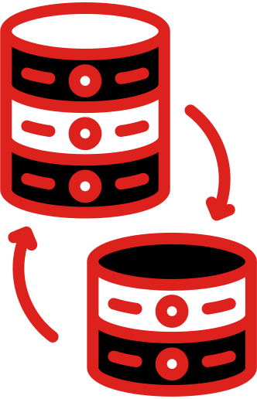
UOB/MSC BIOINFORMATICS
Mustafa Maytham Mahmood
Rusul Hayder Abd Zaid
Mustafa Yarub Abdul-Hussein
Noor Abd Alkareem Hadi Salman
DATA
SPLITTING
one of pre-processing techniques

Slide 2
List of key concepts
Our Agenda for Today
- what is DATA SPLITTING ?
-Analogy
- Why We Need Data Splitting?
- Ways to Partition Data
.-Applications
-implementation in python:

Slide 3
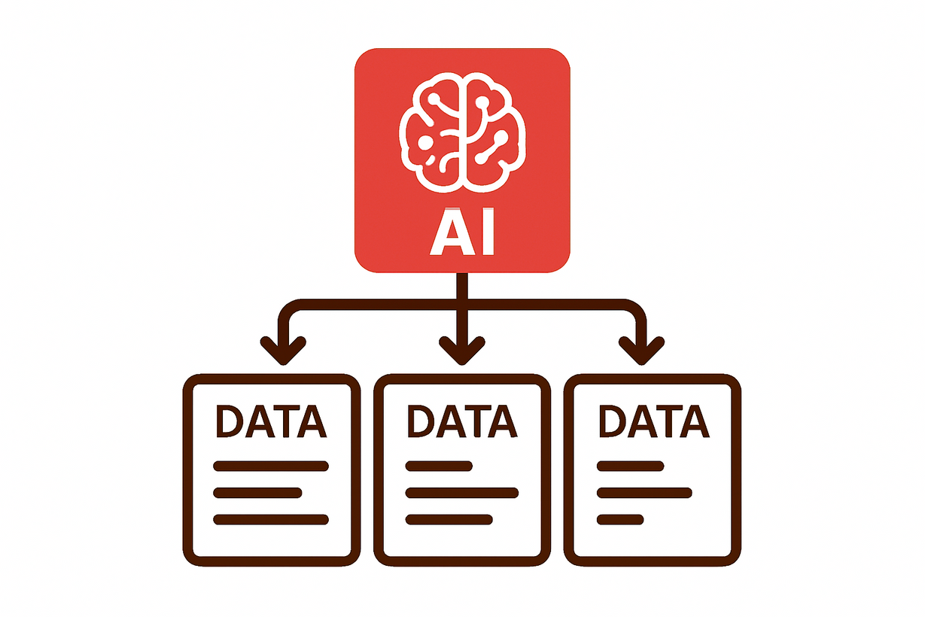
What is
DATA SPLITTING?
Data splitting is the process of dividing your collected dataset into distinct subsets for the specific purposes of training, validating, and testing a machine learning model.

Slide 4

Analogy
·The textbook is your training set (you learn from it).
·The practice problems are your validation set (you test your understanding as you learn).
·The final exam itself is the test set (the ultimate, unbiased test of your knowledge).

Slide 5

“Hiding within those mounds of data is knowledge that could change the life of a patient, or change the world.”

Slide 6
Why We Need Data Splitting?
Training Set
Validation Set
Testing Set
Model Learn Pattern
Select the Model and tuning it
Unbiased Ultimate evaluation
No Data Leakage
Prevent test data leakage

Slide 7
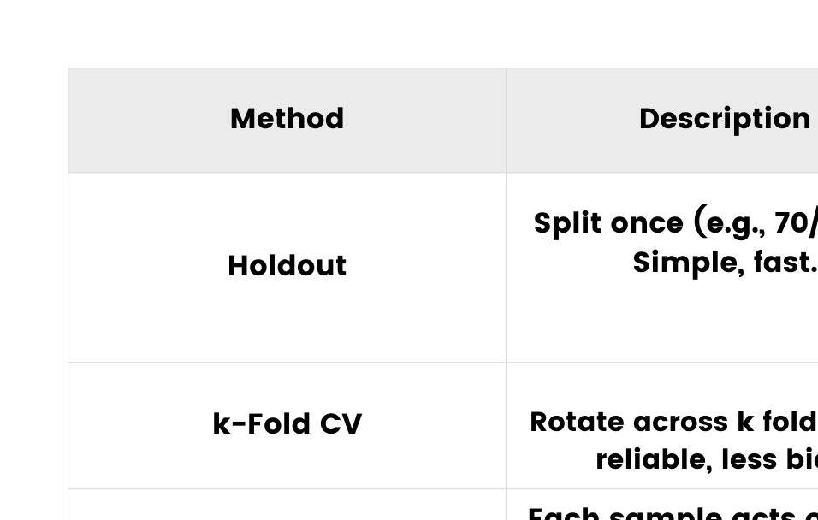
Ways to Partition Data

Slide 8



Applications
Healthcare
Predicting patient readmission; test set shows if model is reliable for clinical use
Automotive
Training a self-driving car's vision system. The test set contains never-before-seen road scenarios to rigorously evaluate safety.
E-Commerce
Creating a recommendation engine. Splitting user interaction data chronologically to test if the model can accurately predict future purchases.

Slide 9
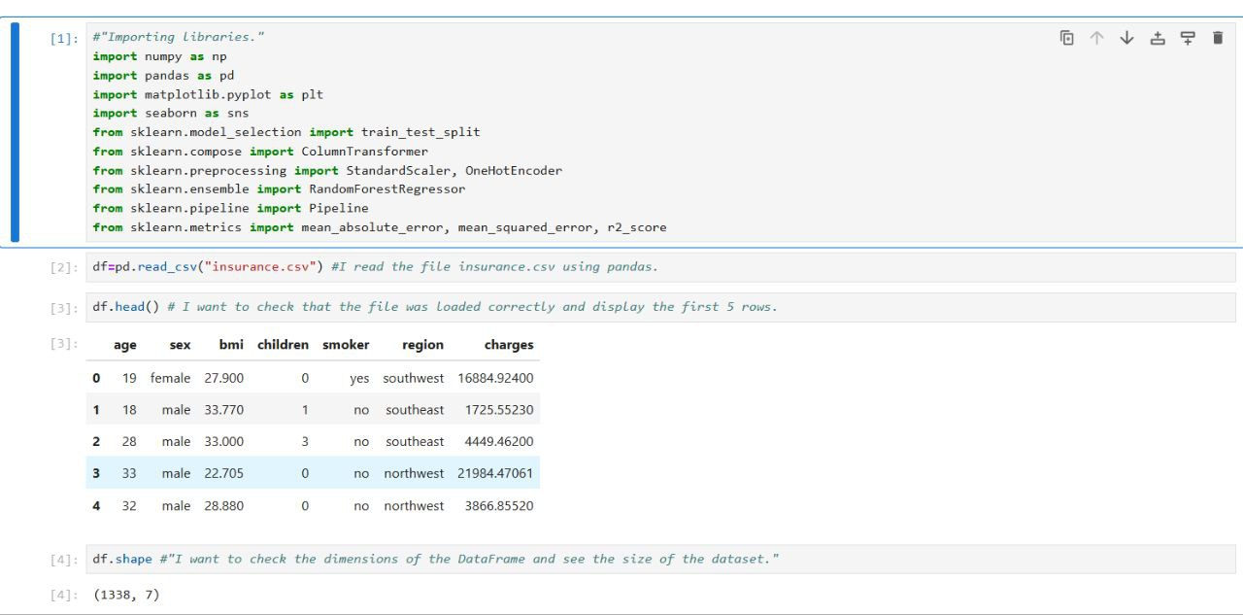
implementation in python:

Slide 10
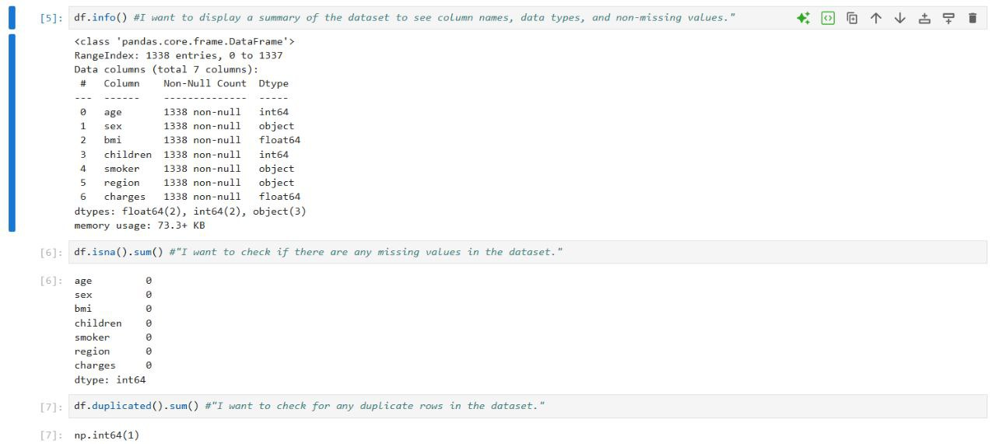
implementation in python:

Slide 11
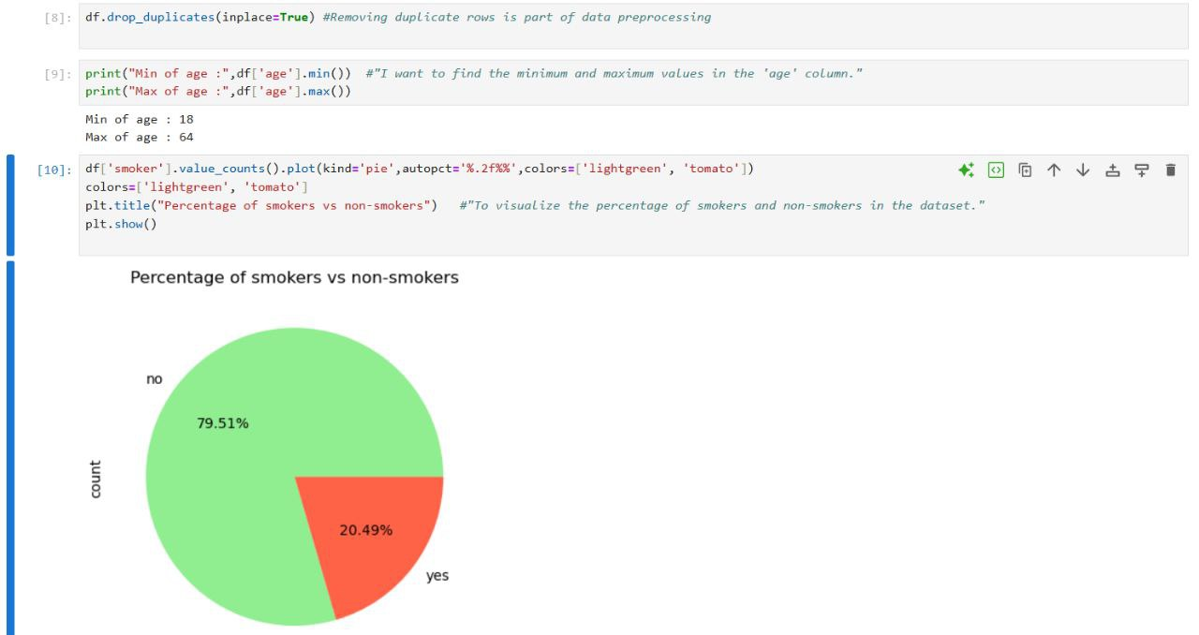
implementation in python:

Slide 12
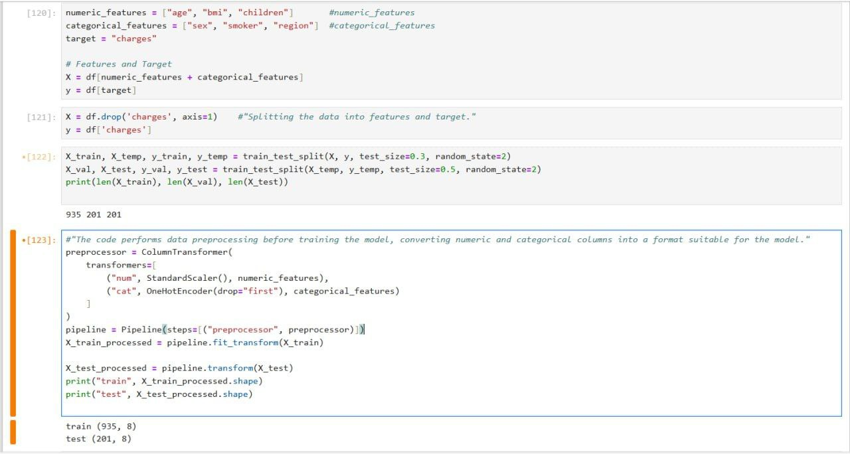
implementation in python:

Slide 13
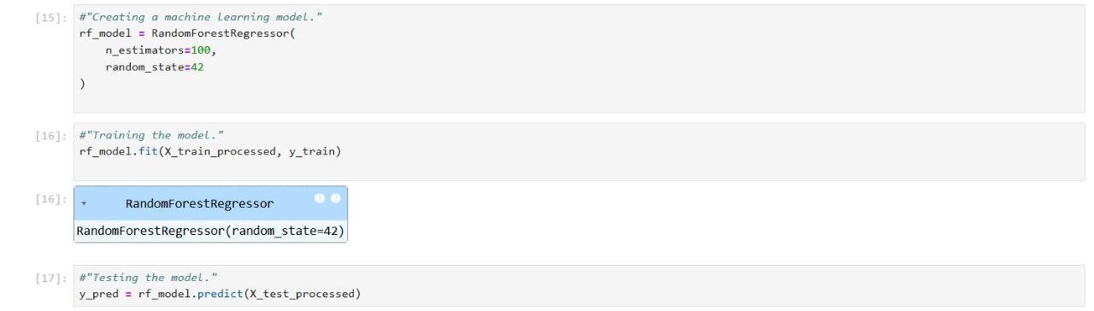
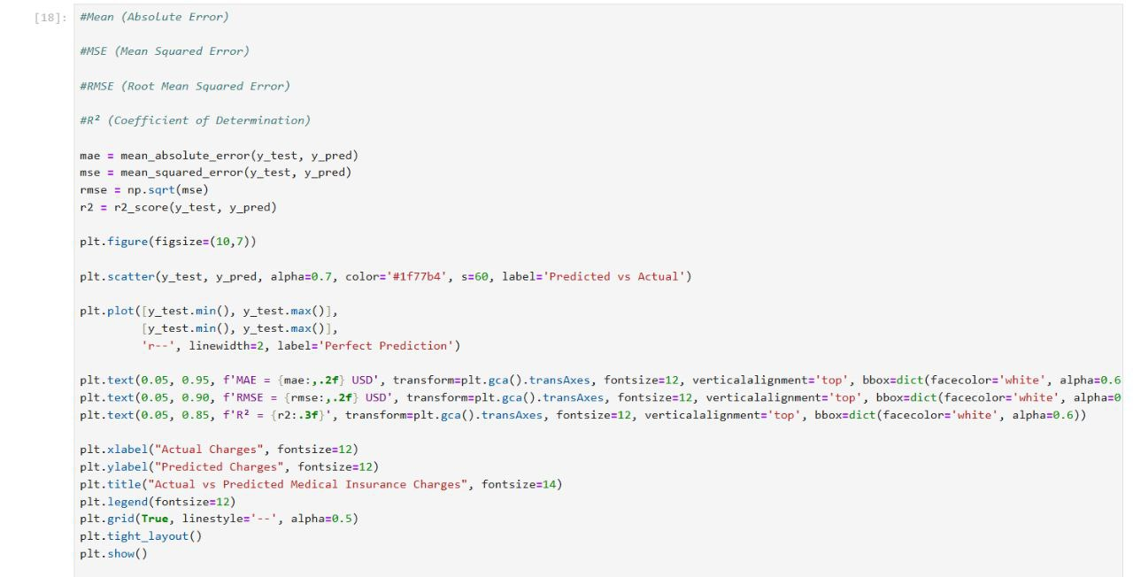

Slide 14
